Slide 1
LLVM Coroutines
Bringing resumable functions to LLVM

Slide 2
Coroutines
Subroutine A
Coroutine C
Subroutine A
Subroutine B
…
…
C start
B start
Introduced in 1958 by Melvin Conway
Donald Knuth, 1968: “generalization of subroutine”
call C
call B
suspend
end
 | subroutines | coroutines
call | Allocate frame, pass parameters | Allocate frame, pass parameters
return | Free frame, return result | Free frame, return eventual result
suspend | x | yes
resume | x | yes
resume C
B start
suspend
call B
resume C
end
end
…
…

Slide 3
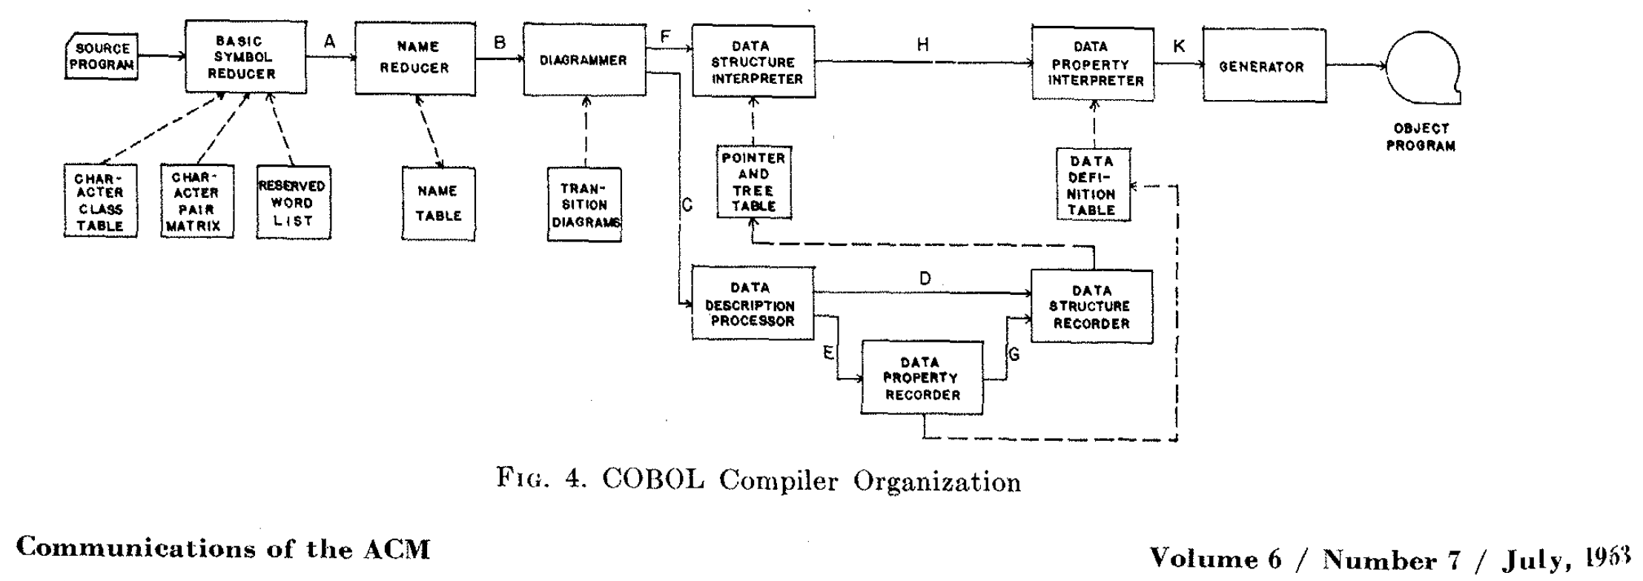
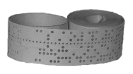
Only with Coroutines. 100 cards per minute!

Slide 4
Subroutines vs Coroutines
…
B start
B return
Address
…
C start
C return
Address
call B
call C
C resume
address
return
suspend
end
B start
resume C
suspend
call B
resume C
return
return
…
…
Subroutine A
Subroutine B
Subroutine A
Coroutine C

Slide 5
Algol-60

Slide 6
Normal Functions
Stack Pointer
Locals of H
Return Address
H’s Activation
Record
Parameters of H
Stack Pointer
Locals of G
Return Address
G’s Activation
Record
Parameters of G
Stack Pointer
Locals of F
Return Address
F’s Activation
Record
Parameters of F
…
Thread Stack

Slide 7
Normal Functions
Stack Pointer
Locals of H
Return Address
H’s Activation
Record
Parameters of H
Stack Pointer
Locals of G
Return Address
G’s Activation
Record
Parameters of G
Stack Pointer
Locals of F
Return Address
F’s Activation
Record
Parameters of F
…
Thread Stack

Slide 8
Coroutines using Side Stacks
Stack Pointer
Locals of H
Return Address
H’s Activation
Record
Parameters of H
Locals of G
Coroutine G’s Activation Record
Parameters of G
Stack Pointer
Fiber Context
Locals of F
Return Address
Thread Context:
IP,RSP,RAX,RCX
RDX,…
RDI,
etc
Return Address
F’s Activation
Record
Old Stack Top
Parameters of F
Saved Registers
Saved Registers
…
Side Stack
Thread 1 Stack

Slide 9
Coroutines using Side Stacks (Suspend)
Stack Pointer
Locals of H
Return Address
H’s Activation
Record
Parameters of H
Locals of G
Coroutine G’s
Activation Record
Parameters of G
Fiber Context
Locals of F
Return Address
Thread Context:
IP,RSP,RAX,RCX
RDX,…
RDI,RSI,
etc
Return Address
F’s Activation
Record
Old Stack Top
Parameters of F
Saved Registers
Saved Registers
Saved Registers
…
Side Stack
Thread 1 Stack

Slide 10
Coroutines using Side Stacks (Resume)
Locals of H
Return Address
H’s Activation
Record
Parameters of H
Locals of G
Coroutine G’s
Activation Record
Parameters of G
Stack Pointer
Fiber Context
Locals of Z
Return Address
Return Address
Z’s Activation
Record
Return Address
Old Stack Top
Parameters of Z
Saved Registers
…
Saved Registers
Saved Registers
Side Stack
Thread 2 Stack

Slide 11
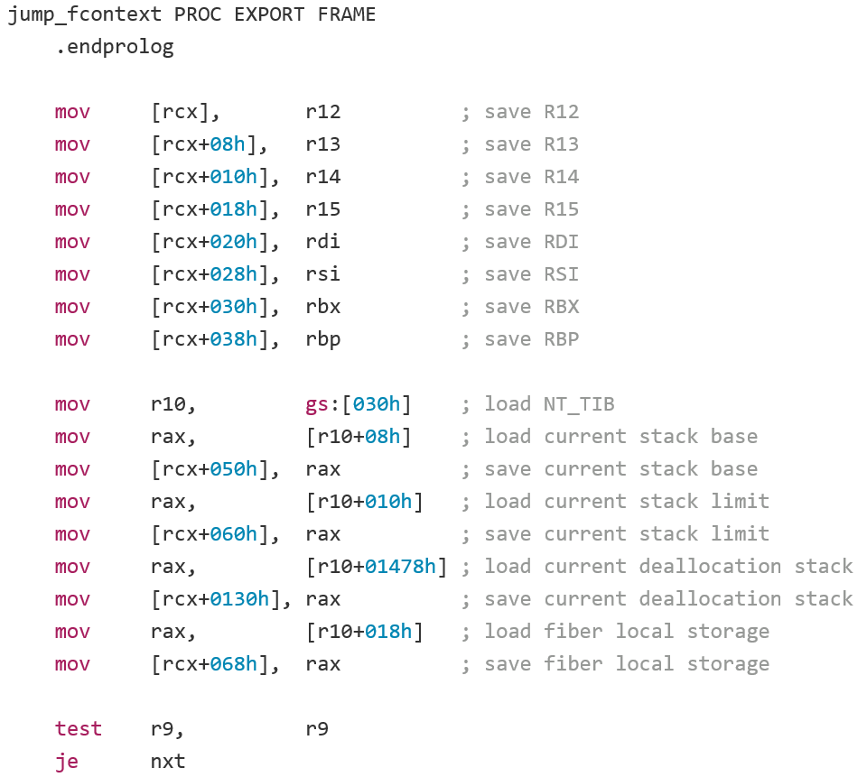
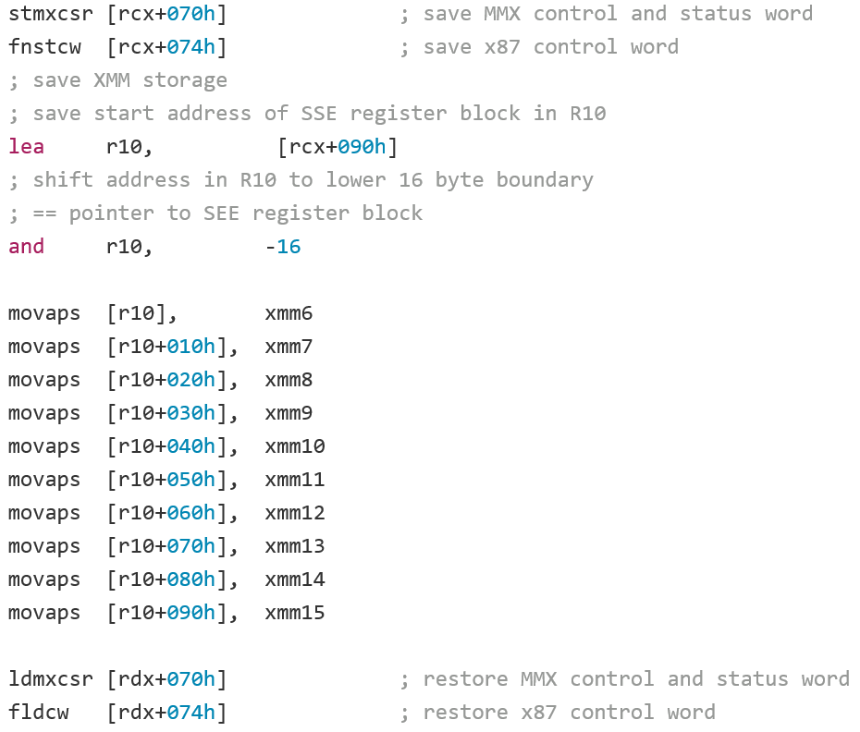
https://github.com/mirror/boost/blob/master/libs/context/src/asm/jump_x86_64_ms_pe_masm.asm (1/2)

Slide 12
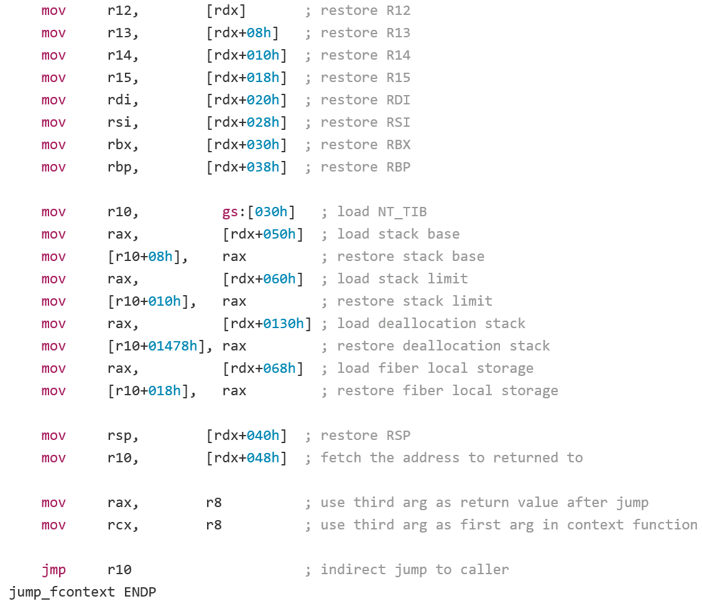
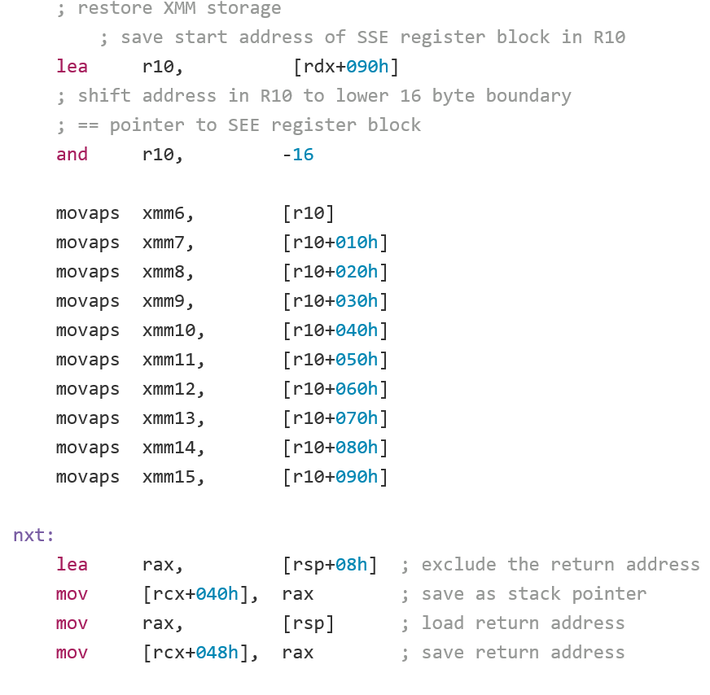
https://github.com/mirror/boost/blob/master/libs/context/src/asm/jump_x86_64_ms_pe_masm.asm (2/2)

Slide 13
Memory Footprint
Fiber State
(chained stack)
(reallocate and copy)
1 meg of stack
4k stacklet
1k stack
2k stack
4k stacklet
4k stack
8k stack
4k stacklet
16k stack
4k stacklet
…
…
Extra overhead when calling external code

Slide 14
Compiler based coroutines
generator<int> f() {
for (int i = 0; i < 5; ++i) {
co_yield i;
}
generator<int> f() { f.state *mem = new f$state;
mem->__resume_fn = &f$resume;
mem->__destroy_fn = &f$destroy;
return {mem};
}
struct f$state {
void *__resume_fn;
void *__destroy_fn; int __resume_index = 0; int i, __current_value; };
void f$resume(f$state *s) {
switch (s->__resume_index) {
case 0: s->i = 0; s->resume_index = 1; break; case 1: if( ++s->i == 5) { s->resume_index = 2; return; }
}
s->__current_value = s->i;
}
void f$destroy(f$state *s) { delete s;
}

Slide 15
Compiler Based Coroutines
Stack Pointer
Locals of H
Return Address
H’s Activation
Record
Parameters of H
Stack Pointer
Locals of G
struct G$state {
void* __resume_fn;
void* __destroy_fn; int __resume_index; locals, temporaries
that need to preserve values
across suspend points };
Return Address
G’s Activation
Record (Coroutine)
G’s Coroutine
State
Parameters of G
Stack Pointer
Locals of F
Return Address
F’s Activation
Record
Parameters of F
…
Thread 1 Stack

Slide 16
Compiler Based Coroutines
(Suspend)
Stack Pointer
Locals of H
Return Address
H’s Activation
Record
Parameters of H
Stack Pointer
Locals of G
struct G$state {
void* __resume_fn;
void* __destroy_fn; int __resume_index; locals, temporaries
that need to preserve values
across suspend points };
Return Address
G’s Activation
Record
G’s Coroutine
State
Parameters of G
Stack Pointer
Locals of F
Return Address
F’s Activation
Record
Parameters of F
…
Thread 1 Stack

Slide 17
Compiler Based Coroutines
(Resume)
Stack Pointer
Locals of H
Return Address
H’s Activation
Record
Parameters of H
Stack Pointer
Locals of g$resume
struct G$state {
void* __resume_fn;
void* __destroy_fn; int __resume_index; locals, temporaries
that need to preserve values
across suspend points };
Return Address
G$resume’s Activation
Record
G’s Coroutine
State
Parameters of g$resume
Stack Pointer
Locals of X
Return Address
X’s Activation
Record
Parameters of X
…
Thread 2 Stack

Slide 18
Compiler based coroutines
generator<int> f() {
for (int i = 0; i < 5; ++i) {
co_yield i;
}
generator<int> f() { f.state *mem = new f$state;
mem->__resume_fn = &f$resume;
mem->__destroy_fn = &f$destroy;
return {mem};
}
int main() {
for (int v: f())
printf(“%d\n”, v);
}
struct f$state {
void *__resume_fn;
void *__destroy_fn; int __resume_index = 0; int i, __current_value; };
void f$resume(f$state *s) {
switch (s->__resume_index) {
case 0: s->i = 0; s->resume_index = 1; break; case 1: if( ++s->i == 5) { s->resume_index = 2; return; }
}
s->__current_value = s->i;
}
int main() {
printf(“%d\n”, 0);
printf(“%d\n”, 1);
printf(“%d\n”, 2);
printf(“%d\n”, 3);
printf(“%d\n”, 4);
}
void f$destroy(f$state *s) { delete s;
}

Slide 19
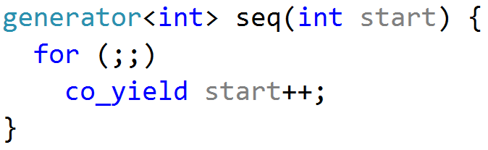
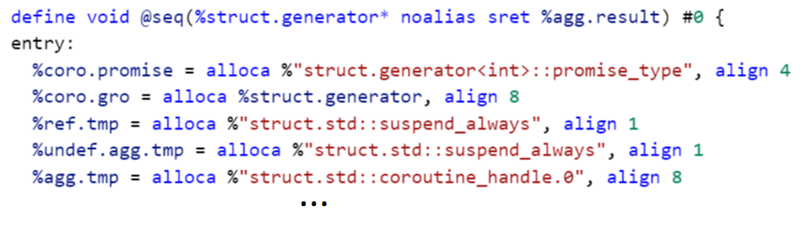
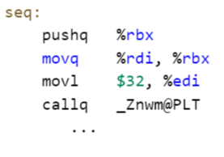
Where would you split a coroutine?
Frontend
Optimizer
Codegen

Slide 20
Where would you split a coroutine?
CGSCC PM
-forceattrs -inferattrs -ipsccp -globalopt -domtree -mem2reg -deadargelim -domtree -basicaa -aa -instcombine -simplifycfg -pgo-icall-prom -basiccg -globals-aa -prune-eh -inline -functionattrs -coro-split -domtree -sroa -early-cse -speculative-execution -lazy-value-info -jump-threading -correlated-propagation -simplifycfg -domtree -basicaa -aa -instcombine -tailcallelim -simplifycfg -reassociate -domtree -loops -loop-simplify -lcssa -basicaa -aa -scalar-evolution -loop-rotate -licm -loop-unswitch -simplifycfg -domtree -basicaa -aa -instcombine -loops -loop-simplify -lcssa -scalar-evolution -indvars -loop-idiom -loop-deletion -loop-unroll -mldst-motion -aa -memdep -gvn -basicaa -aa -memdep -memcpyopt -sccp -domtree -demanded-bits -bdce -basicaa -aa -instcombine -lazy-value-info -jump-threading -correlated-propagation -domtree -basicaa -aa -memdep -dse -loops -loop-simplify -lcssa -aa -scalar-evolution -licm -coro-elide -postdomtree -adce -simplifycfg -domtree -basicaa -aa -instcombine
Late Passes:
-elim-avail-extern -basiccg -rpo-functionattrs -globals-aa -float2int -domtree -loops -loop-simplify -lcssa -basicaa -aa -scalar-evolution -loop-rotate -loop-accesses -lazy-branch-prob -lazy-block-freq -opt-remark-emitter -loop-distribute -loop-simplify -lcssa -branch-prob -block-freq -scalar-evolution -basicaa -aa -loop-accesses -demanded-bits -lazy-branch-prob -lazy-block-freq -opt-remark-emitter -loop-vectorize -loop-simplify -scalar-evolution -aa -loop-accesses -loop-load-elim -basicaa -aa -instcombine -scalar-evolution -demanded-bits -slp-vectorizer -simplifycfg -domtree -basicaa -aa -instcombine -loops -loop-simplify -lcssa -scalar-evolution -loop-unroll -instcombine -loop-simplify -lcssa -scalar-evolution -licm -instsimplify -scalar-evolution -alignment-from-assumptions -strip-dead-prototypes -globaldce -constmerge -coro-cleanup
Early Passes:
-simplifycfg –domtree
-sroa -early-cse
-memoryssa -gvn-hoist

Slide 21
Where would you split a coroutine?
Inliner
PruneEH
FnAttr
…
Devirtization
Detector
sroa
cse
…. 75 more functional passes …
…
x4

Slide 22
Where would you split a coroutine?
Insert a dummy indirect call.
Devirtualize dummy call
Inliner
PruneEH
FnAttr
CoroSplit
Devirtization
Detector
sroa
cse
…. 75 more functional passes …
CoroElide
x4

Slide 23
Where would you split a coroutine?
1. Build Coroutine Frame
2. Split Coroutine into
start
resume
destroy
Inliner
PruneEH
FnAttr
CoroSplit
Devirtization
Detector
sroa
cse
…. 75 more functional passes …
CoroElide
x4

Slide 24
Where would you split a coroutine?
1. Build Coroutine Frame
2. Split Coroutine into
start
resume
destroy
Devirtualize Resume/Destroy
Elide Heap Allocations
Inliner
PruneEH
FnAttr
CoroSplit
Devirtization
Detector
sroa
cse
…. 75 more functional passes …
CoroElide
x4

Slide 25
Coroutine intrinsics
define i32 @main() {
entry:
%hdl = call i8* @gen(i32 9)
call void @llvm.coro.resume(i8* %hdl)
call void @llvm.coro.resume(i8* %hdl)
call void @llvm.coro.destroy(i8* %hdl)
ret i32 0
}

Slide 26
Let’s code up in LLVM IR this coroutine
void *gen(int n) {
for(;;) {
print(n++);
<suspend> // returns a coroutine
// handle on first suspend
}
}

Slide 27
Same Coroutine in LLVM IR
define i8* @gen(i32 %n) {
entry:
%id = call token @llvm.coro.id(i32 0, i8* null, i8* null, i8* null)
%size = call i32 @llvm.coro.size.i32()
%alloc = call i8* @malloc(i32 %size)
%hdl = call noalias i8* @llvm.coro.begin(token %id, i8* %alloc)
br label %loop
loop:
%n.val = phi i32 [ %n, %entry ], [ %inc, %loop ]
%inc = add nsw i32 %n.val, 1
call void @print(i32 %n.val)
%0 = call i8 @llvm.coro.suspend(token none, i1 false)
switch i8 %0, label %suspend_or_ret [i8 0, label %loop
i8 1, label %cleanup]
cleanup:
%mem = call i8* @llvm.coro.free(token %id, i8* %hdl)
call void @free(i8* %mem)
br label %suspend_or_ret
suspend_or_ret:
%unused = call i1 @llvm.coro.end(i8* %hdl, i1 false)
ret i8* %hdl
}

Slide 28
Same Coroutine in LLVM IR
define i8* @gen(i32 %n) {
entry:
%id = call token @llvm.coro.id(i32 0, i8* null, i8* null, i8* null)
%size = call i32 @llvm.coro.size.i32()
%alloc = call i8* @malloc(i32 %size)
%hdl = call noalias i8* @llvm.coro.begin(token %id, i8* %alloc)
br label %loop
loop:
%n.val = phi i32 [ %n, %entry ], [ %inc, %loop ]
%inc = add nsw i32 %n.val, 1
call void @print(i32 %n.val)
%0 = call i8 @llvm.coro.suspend(token none, i1 false)
switch i8 %0, label %suspend_or_ret [i8 0, label %loop
i8 1, label %cleanup]
cleanup:
%mem = call i8* @llvm.coro.free(token %id, i8* %hdl)
call void @free(i8* %mem)
br label %suspend_or_ret
suspend_or_ret:
call void @llvm.coro.end(i8* %hdl, i1 false)
ret i8* %hdl
}
ALLOCATION PART
USER BODY
DEALLOCATION PART
SUSPEND/RETURN PART

Slide 29
Same Coroutine in LLVM IR
define i8* @gen(i32 %n) {
entry:
%id = call token @llvm.coro.id(i32 0, i8* null, i8* null, i8* null)
%size = call i32 @llvm.coro.size.i32()
%alloc = call i8* @malloc(i32 %size)
%hdl = call noalias i8* @llvm.coro.begin(token %id, i8* %alloc)
br label %loop
loop:
%n.val = phi i32 [ %n, %entry ], [ %inc, %loop ]
%inc = add nsw i32 %n.val, 1
call void @print(i32 %n.val)
%0 = call i8 @llvm.coro.suspend(token none, i1 false)
switch i8 %0, label %suspend_or_ret [i8 0, label %loop
i8 1, label %cleanup]
cleanup:
%mem = call i8* @llvm.coro.free(token %id, i8* %hdl)
call void @free(i8* %mem)
br label %suspend_or_ret
suspend_or_ret:
call void @llvm.coro.end(i8* %hdl, i1 false)
ret i8* %hdl
}
USER BODY
DEALLOCATION PART
SUSPEND/RETURN PART

Slide 30
Same Coroutine in LLVM IR
define i8* @gen(i32 %n) {
entry:
%id = call token @llvm.coro.id(i32 0, i8* null, i8* null, i8* null)
%size = call i32 @llvm.coro.size.i32()
%alloc = call i8* @malloc(i32 %size)
%hdl = call noalias i8* @llvm.coro.begin(token %id, i8* %alloc)
br label %loop
loop:
%n.val = phi i32 [ %n, %entry ], [ %inc, %loop ]
%inc = add nsw i32 %n.val, 1
call void @print(i32 %n.val)
%0 = call i8 @llvm.coro.suspend(token none, i1 false)
switch i8 %0, label %suspend_or_ret [i8 0, label %loop
i8 1, label %cleanup]
cleanup:
%mem = call i8* @llvm.coro.free(token %id, i8* %hdl)
call void @free(i8* %mem)
br label %suspend_or_ret
suspend_or_ret:
call void @llvm.coro.end(i8* %hdl, i1 false)
ret i8* %hdl
}
USER BODY
SUSPEND/RETURN PART

Slide 31
Same Coroutine in LLVM IR
define i8* @gen(i32 %n) {
entry:
%id = call token @llvm.coro.id(i32 0, i8* null, i8* null, i8* null)
%size = call i32 @llvm.coro.size.i32()
%alloc = call i8* @malloc(i32 %size)
%hdl = call noalias i8* @llvm.coro.begin(token %id, i8* %alloc)
br label %loop
loop:
%n.val = phi i32 [ %n, %entry ], [ %inc, %loop ]
%inc = add nsw i32 %n.val, 1
call void @print(i32 %n.val)
%0 = call i8 @llvm.coro.suspend(token none, i1 false)
switch i8 %0, label %suspend_or_ret [i8 0, label %loop
i8 1, label %cleanup]
cleanup:
%mem = call i8* @llvm.coro.free(token %id, i8* %hdl)
call void @free(i8* %mem)
br label %suspend_or_ret
suspend_or_ret:
call void @llvm.coro.end(i8* %hdl, i1 false)
ret i8* %hdl
}
ALLOCATION PART
USER BODY
DEALLOCATION PART

Slide 32
Same Coroutine in LLVM IR
define i8* @gen(i32 %n) {
entry:
%id = call token @llvm.coro.id(i32 0, i8* null, i8* null, i8* null)
%size = call i32 @llvm.coro.size.i32()
%alloc = call i8* @malloc(i32 %size)
%hdl = call noalias i8* @llvm.coro.begin(token %id, i8* %alloc)
br label %loop
loop:
%n.val = phi i32 [ %n, %entry ], [ %inc, %loop ]
%inc = add nsw i32 %n.val, 1
call void @print(i32 %n.val)
%0 = call i8 @llvm.coro.suspend(token none, i1 false)
switch i8 %0, label %suspend_or_ret [i8 0, label %loop
i8 1, label %cleanup]
cleanup:
%mem = call i8* @llvm.coro.free(token %id, i8* %hdl)
call void @free(i8* %mem)
br label %suspend_or_ret
suspend_or_ret:
call void @llvm.coro.end(i8* %hdl, i1 false)
ret i8* %hdl
}
ALLOCATION PART
suspend
DEALLOCATION PART
SUSPEND/RETURN PART

Slide 33
Same Coroutine in LLVM IR
define i8* @gen(i32 %n) {
entry:
%id = call token @llvm.coro.id(i32 0, i8* null, i8* null, i8* null)
%size = call i32 @llvm.coro.size.i32()
%alloc = call i8* @malloc(i32 %size)
%hdl = call noalias i8* @llvm.coro.begin(token %id, i8* %alloc)
br label %loop
loop:
%n.val = phi i32 [ %n, %entry ], [ %inc, %loop ]
%inc = add nsw i32 %n.val, 1
call void @print(i32 %n.val)
%0 = call i8 @llvm.coro.suspend(token none, i1 false)
switch i8 %0, label %suspend_or_ret [i8 0, label %loop
i8 1, label %cleanup]
cleanup:
%mem = call i8* @llvm.coro.free(token %id, i8* %hdl)
call void @free(i8* %mem)
br label %suspend_or_ret
suspend_or_ret:
call void @llvm.coro.end(i8* %hdl, i1 false)
ret i8* %hdl
}
ALLOCATION PART
suspend
DEALLOCATION PART
@llvm.coro.suspend
-1 | In start function
0 | In resume function
1 | In destroy function
SUSPEND/RETURN PART

Slide 34
Build Coroutine Frame
define i8* @gen(i32 %n) {
entry:
…
br label %loop
loop:
%n.val = phi i32 [ %n, %entry ], [ %inc, %loop ]
%inc = add nsw i32 %n.val, 1
call void @print(i32 %n.val)
%0 = call i8 @llvm.coro.suspend(token none, i1 false)
switch i8 %0, label %suspend_or_ret [i8 0, label %loop
i8 1, label %cleanup]
cleanup:
…
}

Slide 35
Build Coroutine Frame: Simplify PHI Nodes
define i8* @gen(i32 %n) {
…
loop.from.entry:
%n.val.from.entry = phi i32 [ %n, %entry ]
br label %loop
loop:
%n.val = phi i32 [%n.val.from.entry, %loop.from.entry ], [ %inc, %loop ]
%inc = add nsw i32 %n.val, 1
call void @print(i32 %n.val)
%0 = call i8 @llvm.coro.suspend(token none, i1 false)
switch i8 %0, label %suspend_or_ret [i8 0, label %loop
i8 1, label %cleanup]
cleanup:
…
}

Slide 36
Build Coroutine Frame: Simplify PHI Nodes
define i8* @gen(i32 %n) {
…
loop.from.entry:
%n.val.from.entry = phi i32 [ %n, %entry ]
br label %loop
loop:
%n.val = phi i32 [%n.val.from.entry, %loop.from.entry ], [ %inc.from.loop, %loop.from.loop ]
%inc = add nsw i32 %n.val, 1
call void @print(i32 %n.val)
%0 = call i8 @llvm.coro.suspend(token none, i1 false)
switch i8 %0, label %suspend_or_ret [i8 0, label %loop.from.loop
i8 1, label %cleanup]
loop.from.loop:
%inc.from.loop = phi i32 [ %inc, %loop ]
br label %loop
…
}

Slide 37
Build Coroutine Frame
define i8* @gen(i32 %n) {
…
loop.from.entry:
%n.val.from.entry = phi i32 [ %n, %entry ]
br label %loop
loop:
%n.val = phi i32 [%n.val.from.entry, %loop.from.entry ], [ %inc.from.loop, %loop.from.loop ]
%inc = add nsw i32 %n.val, 1
call void @print(i32 %n.val)
%0 = call i8 @llvm.coro.suspend(token none, i1 false)
switch i8 %0, label %suspend_or_ret [i8 0, label %loop.from.loop
i8 1, label %cleanup]
loop.from.loop:
%inc.from.loop = phi i32 [ %inc, %loop ]
br label %loop
…
}
%f.frame = type { }

Slide 38
Build Coroutine Frame
define i8* @gen(i32 %n) {
…
loop.from.entry:
%n.val.from.entry = phi i32 [ %n, %entry ]
br label %loop
loop:
%n.val = phi i32 [%n.val.from.entry, %loop.from.entry ], [ %inc.from.loop, %loop.from.loop ]
%inc = add nsw i32 %n.val, 1
call void @print(i32 %n.val)
%0 = call i8 @llvm.coro.suspend(token none, i1 false)
switch i8 %0, label %suspend_or_ret [i8 0, label %loop.from.loop
i8 1, label %cleanup]
loop.from.loop:
%inc.from.loop = phi i32 [ %inc, %loop ]
br label %loop
…
}
%f.frame = type { }

Slide 39
Build Coroutine Frame
define i8* @gen(i32 %n) {
…
loop.from.entry:
%n.val.from.entry = phi i32 [ %n, %entry ]
br label %loop
loop:
%n.val = phi i32 [%n.val.from.entry, %loop.from.entry], [ %inc1, %loop.from.loop]
%inc = add nsw i32 %n.val, 1
call void @print(i32 %n.val)
%0 = call i8 @llvm.coro.suspend(token none, i1 false)
switch i8 %0, label %suspend_or_ret [i8 0, label %loop.from.loop
i8 1, label %cleanup]
loop.from.loop:
%inc1 = add nsw i32 %n.val, 1
br label %loop
…
}
%f.frame = type { }

Slide 40
Build Coroutine Frame
define i8* @gen(i32 %n) {
…
loop.from.entry:
%n.val.from.entry = phi i32 [ %n, %entry ]
br label %loop
loop:
%n.val = phi i32 [%n.val.from.entry, %loop.from.entry], [ %inc1, %loop.from.loop]
%inc = add nsw i32 %n.val, 1
call void @print(i32 %n.val)
%0 = call i8 @llvm.coro.suspend(token none, i1 false)
switch i8 %0, label %suspend_or_ret [i8 0, label %loop.from.loop
i8 1, label %cleanup]
loop.from.loop:
%inc1 = add nsw i32 %n.val, 1
br label %loop
…
}
%f.frame = type { }

Slide 41
Build Coroutine Frame
define i8* @gen(i32 %n) {
…
loop.from.entry:
%n.val.from.entry = phi i32 [ %n, %entry ]
br label %loop
loop:
%n.val = phi i32 [%n.val.from.entry, %loop.from.entry], [ %inc1, %loop.from.loop]
%inc = add nsw i32 %n.val, 1
call void @print(i32 %n.val)
%0 = call i8 @llvm.coro.suspend(token none, i1 false)
switch i8 %0, label %suspend_or_ret [i8 0, label %loop.from.loop
i8 1, label %cleanup]
loop.from.loop:
%inc1 = add nsw i32 %n.val, 1
br label %loop
…
}
%f.frame = type { i32 }
%n.val spill

Slide 42
Build Coroutine Frame
define i8* @gen(i32 %n) {
entry:
…
%hdl = call noalias i8* @llvm.coro.begin(token %id, i8* %alloc)
%frame = bitcast i8* %hdl to %f.frame*
br label %loop
loop:
%n.val = phi i32 [%n, %entry ], [ %inc1, %loop.from.loop ]
%inc = add nsw i32 %n.val, 1
call void @print(i32 %n.val)
…
loop.from.loop:
%inc1 = add nsw i32 %n.val, 1
br label %loop
…
}
%f.frame = type { i32 }

Slide 43
Build Coroutine Frame
define i8* @gen(i32 %n) {
entry:
…
%hdl = call noalias i8* @llvm.coro.begin(token %id, i8* %alloc)
%frame = bitcast i8* %hdl to %f.frame*
br label %loop
loop:
%n.val = phi i32 [%n, %entry ], [ %inc.from.loop, %loop.from.loop ]
%n.val.spill.addr = getelementpointer %f.frame, %frame, i32 0, i32 0
store i32 %n.val, i32* %n.val.spill.addr
%inc = add nsw i32 %n.val, 1
call void @print(i32 %n.val)
…
loop.from.loop:
%inc1 = add nsw i32 %n.val, 1
br label %loop
…
}
%f.frame = type { i32 }

Slide 44
Build Coroutine Frame
define i8* @gen(i32 %n) {
entry:
…
%hdl = call noalias i8* @llvm.coro.begin(token %id, i8* %alloc)
%frame = bitcast i8* %hdl to %f.frame*
br label %loop
loop:
%n.val = phi i32 [%n, %entry ], [ %n.val.from.loop, %loop.from.loop ]
%n.val.spill.addr = getelementpointer %f.frame, %frame, i32 0, i32 0
store i32 %n.val, i32* %n.val.spill.addr
%inc = add nsw i32 %n.val, 1
call void @print(i32 %n.val)
…
loop.from.loop:
%n.val.reload = load i32, i32* %n.val.spill.addr
%inc1 = add nsw i32 %n.val.reload, 1
br label %loop
…
}
%f.frame = type { i32 }

Slide 45
Split the coroutine

Slide 46
Split Coroutine
define i8* @gen(i32 %n) {
entry:
…
%hdl = call noalias i8* @llvm.coro.begin(token %id, i8* %alloc)
%frame = bitcast i8* %hdl to %f.frame*
br label %loop
loop:
%n.val = phi i32 [ %n, %entry ], [ %inc1, %loop.from.loop ]
%n.val.spill.addr = getelementpointer %f.frame, %frame, i32 0, i32 0
store i32 %n.val, i32* %n.val.spill.addr
%inc = add nsw i32 %n.val, 1
call void @print(i32 %n.val)
%0 = call i8 @llvm.coro.suspend(token none, i1 false)
switch i8 %0, label %suspend_or_ret [i8 0, label %loop.from.loop
i8 1, label %cleanup]
…
suspend_or_ret:
call void @llvm.coro.end(i8* %hdl, i1 false)
ret i8* %hdl
}

Slide 47
Split Coroutine
define fastcc void @gen.resume(%f.frame* %frame) {
entry:
…
%hdl = call noalias i8* @llvm.coro.begin(token %id, i8* %alloc)
%frame = bitcast i8* %hdl to %f.frame*
br label %loop
loop:
%n.val = phi i32 [ %n, %entry ], [ %inc1, %loop.from.loop ]
%n.val.spill.addr = getelementpointer %f.frame, %frame, i32 0, i32 0
store i32 %n.val, i32* %n.val.spill.addr
%inc = add nsw i32 %n.val, 1
call void @print(i32 %n.val)
%0 = call i8 @llvm.coro.suspend(token none, i1 false)
switch i8 %0, label %suspend_or_ret [i8 0, label %loop.from.loop
i8 1, label %cleanup]
…
suspend_or_ret:
call void @llvm.coro.end(i8* %hdl, i1 false)
ret i8* %hdl
}

Slide 48
Split Coroutine
define fastcc void @gen.resume(%f.frame* %frame) {
entry:
…
%hdl = call noalias i8* @llvm.coro.begin(token %id, i8* %alloc)
%frame = bitcast i8* %hdl to %f.frame*
br label %loop
loop:
%n.val = phi i32 [ %n, %entry ], [ %inc1, %loop.from.loop ]
%n.val.spill.addr = getelementpointer %f.frame, %frame, i32 0, i32 0
store i32 %n.val, i32* %n.val.spill.addr
%inc = add nsw i32 %n.val, 1
call void @print(i32 %n.val)
br label %resume1
resume1:
%0 = call i8 @llvm.coro.suspend(token none, i1 false)
switch i8 %0, label %suspend_or_ret [i8 0, label %loop.from.loop
i8 1, label %cleanup]
…
suspend_or_ret:
call void @llvm.coro.end(i8* %hdl, i1 false)
ret i8* %hdl
}

Slide 49
Split Coroutine
define fastcc void @gen.resume(%f.frame* %frame) {
entry:
…
%hdl = call noalias i8* @llvm.coro.begin(token %id, i8* %alloc)
%frame = bitcast i8* %hdl to %f.frame*
br label %loop
loop:
%n.val = phi i32 [ %n, %entry ], [ %inc1, %loop.from.loop ]
%n.val.spill.addr = getelementpointer %f.frame, %frame, i32 0, i32 0
store i32 %n.val, i32* %n.val.spill.addr
%inc = add nsw i32 %n.val, 1
call void @print(i32 %n.val)
br label %resume1
resume1:
%0 = call i8 @llvm.coro.suspend(token none, i1 false)
switch i8 %0, label %suspend_or_ret [i8 0, label %loop.from.loop
i8 1, label %cleanup]
…
suspend_or_ret:
call void @llvm.coro.end(i8* %hdl, i1 false)
ret i8* %hdl
}

Slide 50
Split Coroutine
define fastcc void @gen.resume(%f.frame* %frame) {
entry:
br label %resume1 ; or a switch based on an index stored in the frame
loop:
%n.val = phi i32 [ %n, %entry ], [ %inc1, %loop.from.loop ]
%n.val.spill.addr = getelementpointer %f.frame, %frame, i32 0, i32 0
store i32 %n.val, i32* %n.val.spill.addr
%inc = add nsw i32 %n.val, 1
call void @print(i32 %n.val)
br label %resume1
resume1:
%0 = call i8 @llvm.coro.suspend(token none, i1 false)
switch i8 %0, label %suspend_or_ret [i8 0, label %loop.from.loop
i8 1, label %cleanup]
…
suspend_or_ret:
call void @llvm.coro.end(i8* %hdl, i1 false)
ret i8* %hdl
}

Slide 51
Split Coroutine
define fastcc void @gen.resume(%f.frame* %frame) {
entry:
br label %resume1 ; or a switch based on an index stored in the frame
loop:
%n.val = phi i32 [ %n, %entry ], [ %inc1, %loop.from.loop ]
%n.val.spill.addr = getelementpointer %f.frame, %frame, i32 0, i32 0
store i32 %n.val, i32* %n.val.spill.addr
%inc = add nsw i32 %n.val, 1
call void @print(i32 %n.val)
br label %resume1
resume1:
%0 = call i8 @llvm.coro.suspend(token none, i1 false)
switch i8 %0, label %suspend_or_ret [i8 0, label %loop.from.loop
i8 1, label %cleanup]
…
suspend_or_ret:
ret void
}

Slide 52
Finishing Touches
Clone gen.resume twice and name the clones: gen.destroy and gen.cleanup
llvm.coro.suspend
-1 | In start function
0 | In resume function
1 | In destroy and cleanup functions
llvm.coro.free(hdl)
0 | In cleanup function
hdl | elsewhere

Slide 53
Split Coroutine
define fastcc void @gen.resume (%f.frame* %frame) {
%n.val.spill.addr = getelementpointer %f.frame, %frame, i32 0, i32 0
%n.val = load i32, i32* %n.val.spill.addr
%inc1 = add nsw i32 %n.val, 1
store i32 %inc1, i32* %n.val.spill.addr
call void @print(i32 %n.val)
ret void
}
define fastcc void @gen.destroy(%f.frame* %frame) {
%mem = bitcast %f.frame* %frame to i8*
call void @free(i8* %mem)
ret void
}
define fastcc void @gen.cleanup(%f.frame* %frame) {
ret void
}

Slide 54
Split Coroutine
define i8* @gen(i32 %n) {
entry:
%id = call token @llvm.coro.id(i32 0, i8* null, i8* null, i8* null)
%alloc = call i8* @malloc(i32 4)
%hdl = call noalias i8* @llvm.coro.begin(token %id, i8* %alloc)
%frame = bitcast i8* %hdl to %f.frame*
%n.val.spill.addr = getelementpointer %f.frame, %frame, i32 0, i32 0
store i32 %n, i32* %n.val.spill.addr
call void @print(i32 %n.val)
ret i8* %hdl
}

Slide 55
Devirtualization and Allocation Elision

Slide 56
Before Inlining
define i32 @main() {
entry:
%hdl = call i8* @gen(i32 9)
call void @llvm.coro.resume(i8* %hdl)
call void @llvm.coro.resume(i8* %hdl)
call void @llvm.coro.destroy(i8* %hdl)
ret i32 0
}

Slide 57
After Inlining
define i32 @main() {
entry:
%id = call token @llvm.coro.id(i32 0, i8* null, i8* null, @f.resumers)
%alloc = call i8* @malloc(i32 4)
%hdl = call noalias i8* @llvm.coro.begin(token %id, i8* %alloc)
%frame = bitcast i8* %hdl to %f.frame*
%n.val.spill.addr = getelementpointer %f.frame, %frame, i32 0, i32 0
store i32 9, i32* %n.val.spill.addr
call void @print(i32 9)
call void @llvm.coro.resume(i8* %hdl)
call void @llvm.coro.resume(i8* %hdl)
call void @llvm.coro.destroy(i8* %hdl)
ret i32 0
}

Slide 58
Devirtualization
define i32 @main() {
entry:
%id = call token @llvm.coro.id(i32 0, i8* null, i8* null, @gen.resumers)
%alloc = call i8* @malloc(i32 4)
%hdl = call noalias i8* @llvm.coro.begin(token %id, i8* %alloc)
%frame = bitcast i8* %hdl to %f.frame*
%n.val.spill.addr = getelementpointer %f.frame, %frame, i32 0, i32 0
store i32 9, i32* %n.val.spill.addr
call void @print(i32 9)
call void @llvm.coro.resume(i8* %hdl)
call void @llvm.coro.resume(i8* %hdl)
call void @llvm.coro.destroy(i8* %hdl)
ret i32 0
}
@gen.resumers = private constant [3 x void (%gen.frame*)*]
[@gen.resume, @gen.destroy, @f.cleanup]

Slide 59
Devirtualization
define i32 @main() {
entry:
%id = call token @llvm.coro.id(i32 0, i8* null, i8* null, @gen.resumers)
%alloc = call i8* @malloc(i32 4)
%hdl = call noalias i8* @llvm.coro.begin(token %id, i8* %alloc)
%frame = bitcast i8* %hdl to %f.frame*
%n.val.spill.addr = getelementpointer %f.frame, %frame, i32 0, i32 0
store i32 9, i32* %n.val.spill.addr
call void @print(i32 9)
call void @gen.resume(%f.frame* %frame)
call void @gen.resume(%f.frame* %frame)
call void @gen.destroy(%f.frame* %frame)
ret i32 0
}
@gen.resumers = private constant [3 x void (%gen.frame*)*]
[@gen.resume, @gen.destroy, @f.cleanup]

Slide 60
Heap Elision
define i32 @main() {
entry:
%id = call token @llvm.coro.id(i32 0, i8* null, i8* null, @gen.resumers)
%alloc = call i8* @malloc(i32 4)
%hdl = call noalias i8* @llvm.coro.begin(token %id, i8* %alloc)
%frame = bitcast i8* %hdl to %f.frame*
%n.val.spill.addr = getelementpointer %f.frame, %frame, i32 0, i32 0
store i32 9, i32* %n.val.spill.addr
call void @print(i32 9)
call void @gen.resume(%f.frame* %frame)
call void @gen.resume(%f.frame* %frame)
call void @gen.destroy(%f.frame* %frame)
ret i32 0
}

Slide 61
Heap Elision
define i32 @main() {
entry:
%id = call token @llvm.coro.id(i32 0, i8* null, i8* null, @gen.resumers)
%frame = alloca %f.frame
%n.val.spill.addr = getelementpointer %f.frame, %frame, i32 0, i32 0
store i32 9, i32* %n.val.spill.addr
call void @print(i32 9)
call void @gen.resume(%f.frame* %frame)
call void @gen.resume(%f.frame* %frame)
call void @gen.cleanup(%f.frame* %frame)
ret i32 0
}

Slide 62
At the end of –O2
define i32 @main() {
entry:
call void @print(i32 9)
call void @print(i32 10)
call void @print(i32 11)
ret i32 0
}

Slide 63
C++ Coroutine Design Goals
Scalable (to billions of concurrent coroutines)
Efficient (resume and suspend operations comparable in cost to a function call overhead)
Seamless interaction with existing facilities with no overhead
Open ended coroutine machinery allowing library designers to develop coroutine libraries exposing various high-level semantics, such as generators, goroutines, tasks and more.
Usable in environments where exceptions are forbidden or not available

Slide 64
LLVM/Clang Coroutines Great thanks to:
Alexey Bataev
Chandler Carruth
David Majnemer
Eli Friedman
Eric Fiselier
Hal Finkel
Jim Radigan
Lewis Baker
Mehdi Amini
Richard Smith
Sanjoy Das
Victor Tong

Slide 65
More Info & Status
LLVM Coroutines: http://llvm.org/docs/Coroutines.html experimental implementation is in the trunk of LLVM
opt flag –enable-coroutines to try them out
Examples: https://github.com/llvm-mirror/llvm/tree/master/test/Transforms/Coroutines
C++ Coroutines:
http://wg21.link/P0057
MSVC – now
Clang Coroutines, soon, Clang 4.0 - possible

Slide 66
Questions?

Slide 67
More Work in LLVM
A coroutine frame is bigger than it could be. Adding stack packing and stack coloring like optimization on the coroutine frame will result in tighter coroutine frames.
Take advantage of the lifetime intrinsics for the data that goes into the coroutine frame. Leave lifetime intrinsics as is for the data that stays in allocas.
The CoroElide optimization pass relies on coroutine ramp function to be inlined. It would be beneficial to split the ramp function further to increase the chance that it will get inlined into its caller.
Design a convention that would make it possible to apply coroutine heap elision optimization across ABI boundaries.
Cannot handle coroutines with inalloca parameters (used in x86 on Windows).
Alignment is ignored by coro.begin and coro.free intrinsics.
Make required changes to make sure that coroutine optimizations work with LTO.

Slide 68
Backup

Slide 69
Why coroutines?
int copy(Stream streamR, Stream streamW)
{
char buf[512];
int cnt = 0;
int total = 0;
do
{
cnt = streamR.read(sizeof(buf), buf);
if (cnt == 0) break;
cnt = streamW.write(cnt, buf);
total += count;
}
while (cnt > 0);
return total;
}

Slide 70
Why coroutines?
future<int> copy(Stream streamR, Stream streamW)
{
char buf[512];
int cnt = 0;
int total = 0;
do
{
cnt = co_await streamR.read(sizeof(buf), buf);
if (cnt == 0) break;
cnt = co_await streamW.write(cnt, buf);
total += count;
}
while (cnt > 0);
co_return total;
}

Slide 71
Why coroutines?
future<void> copy(Stream r, Stream w) {
struct State {
Stream streamR, streamW;
char buf[512];
char total = 0;
State(Stream& r, Stream& w) : streamR(move(r)), streamW(move(streamW)) {}
};
auto state = make_shared<State>(streamR, streamW);
return do_while([state]() -> future<bool> {
return state->streamR.read(512, state->buf)
.then([state](int count)) {
return (count == 0) ? make_ready_future(false)
: [state, count] {
return state->streamR.write(count, state->buf)
.then([state](int count) {
state->total += count; return make_ready_future(count > 0);
})();
})
;
}).then([state](auto){ return make_ready_future(state->total)});
;
}

Slide 72
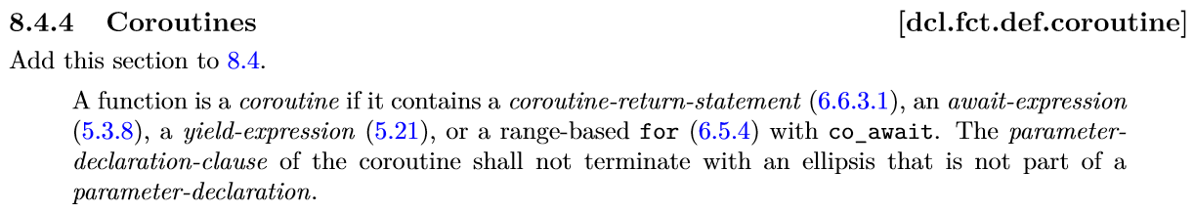
Coroutines in C++
generator<char> hello() {
for (auto ch: "Hello, world\n") co_yield ch;
}
int main() { for (auto ch : hello()) cout << ch;
}
future<void> sleepy() { cout << “Going to sleep…\n";
co_await sleep_for(1ms);
cout << “Woke up\n";
co_return 42;
}
int main() { cout << sleepy.get();
}

Slide 73
Coroutines are popular!
Python: PEP 0492
async def abinary(n): if n <= 0: return 1 l = await abinary(n - 1) r = await abinary(n - 1) return l + 1 + r
DART 1.9
Future<int> getPage(t) async {
var c = new http.Client();
try {
var r = await c.get('http://url/search?q=$t');
print(r);
return r.length();
} finally {
await c.close();
}
}
C#
async Task<string> WaitAsynchronouslyAsync()
{ await Task.Delay(10000);
return "Finished";
}
HACK
async function gen1(): Awaitable<int> { $x = await Batcher::fetch(1); $y = await Batcher::fetch(2);
return $x + $y; }
C++20?
future<string> WaitAsynchronouslyAsync()
{ co_await sleep_for(10ms);
co_return "Finished“s;
}

